Slide 1
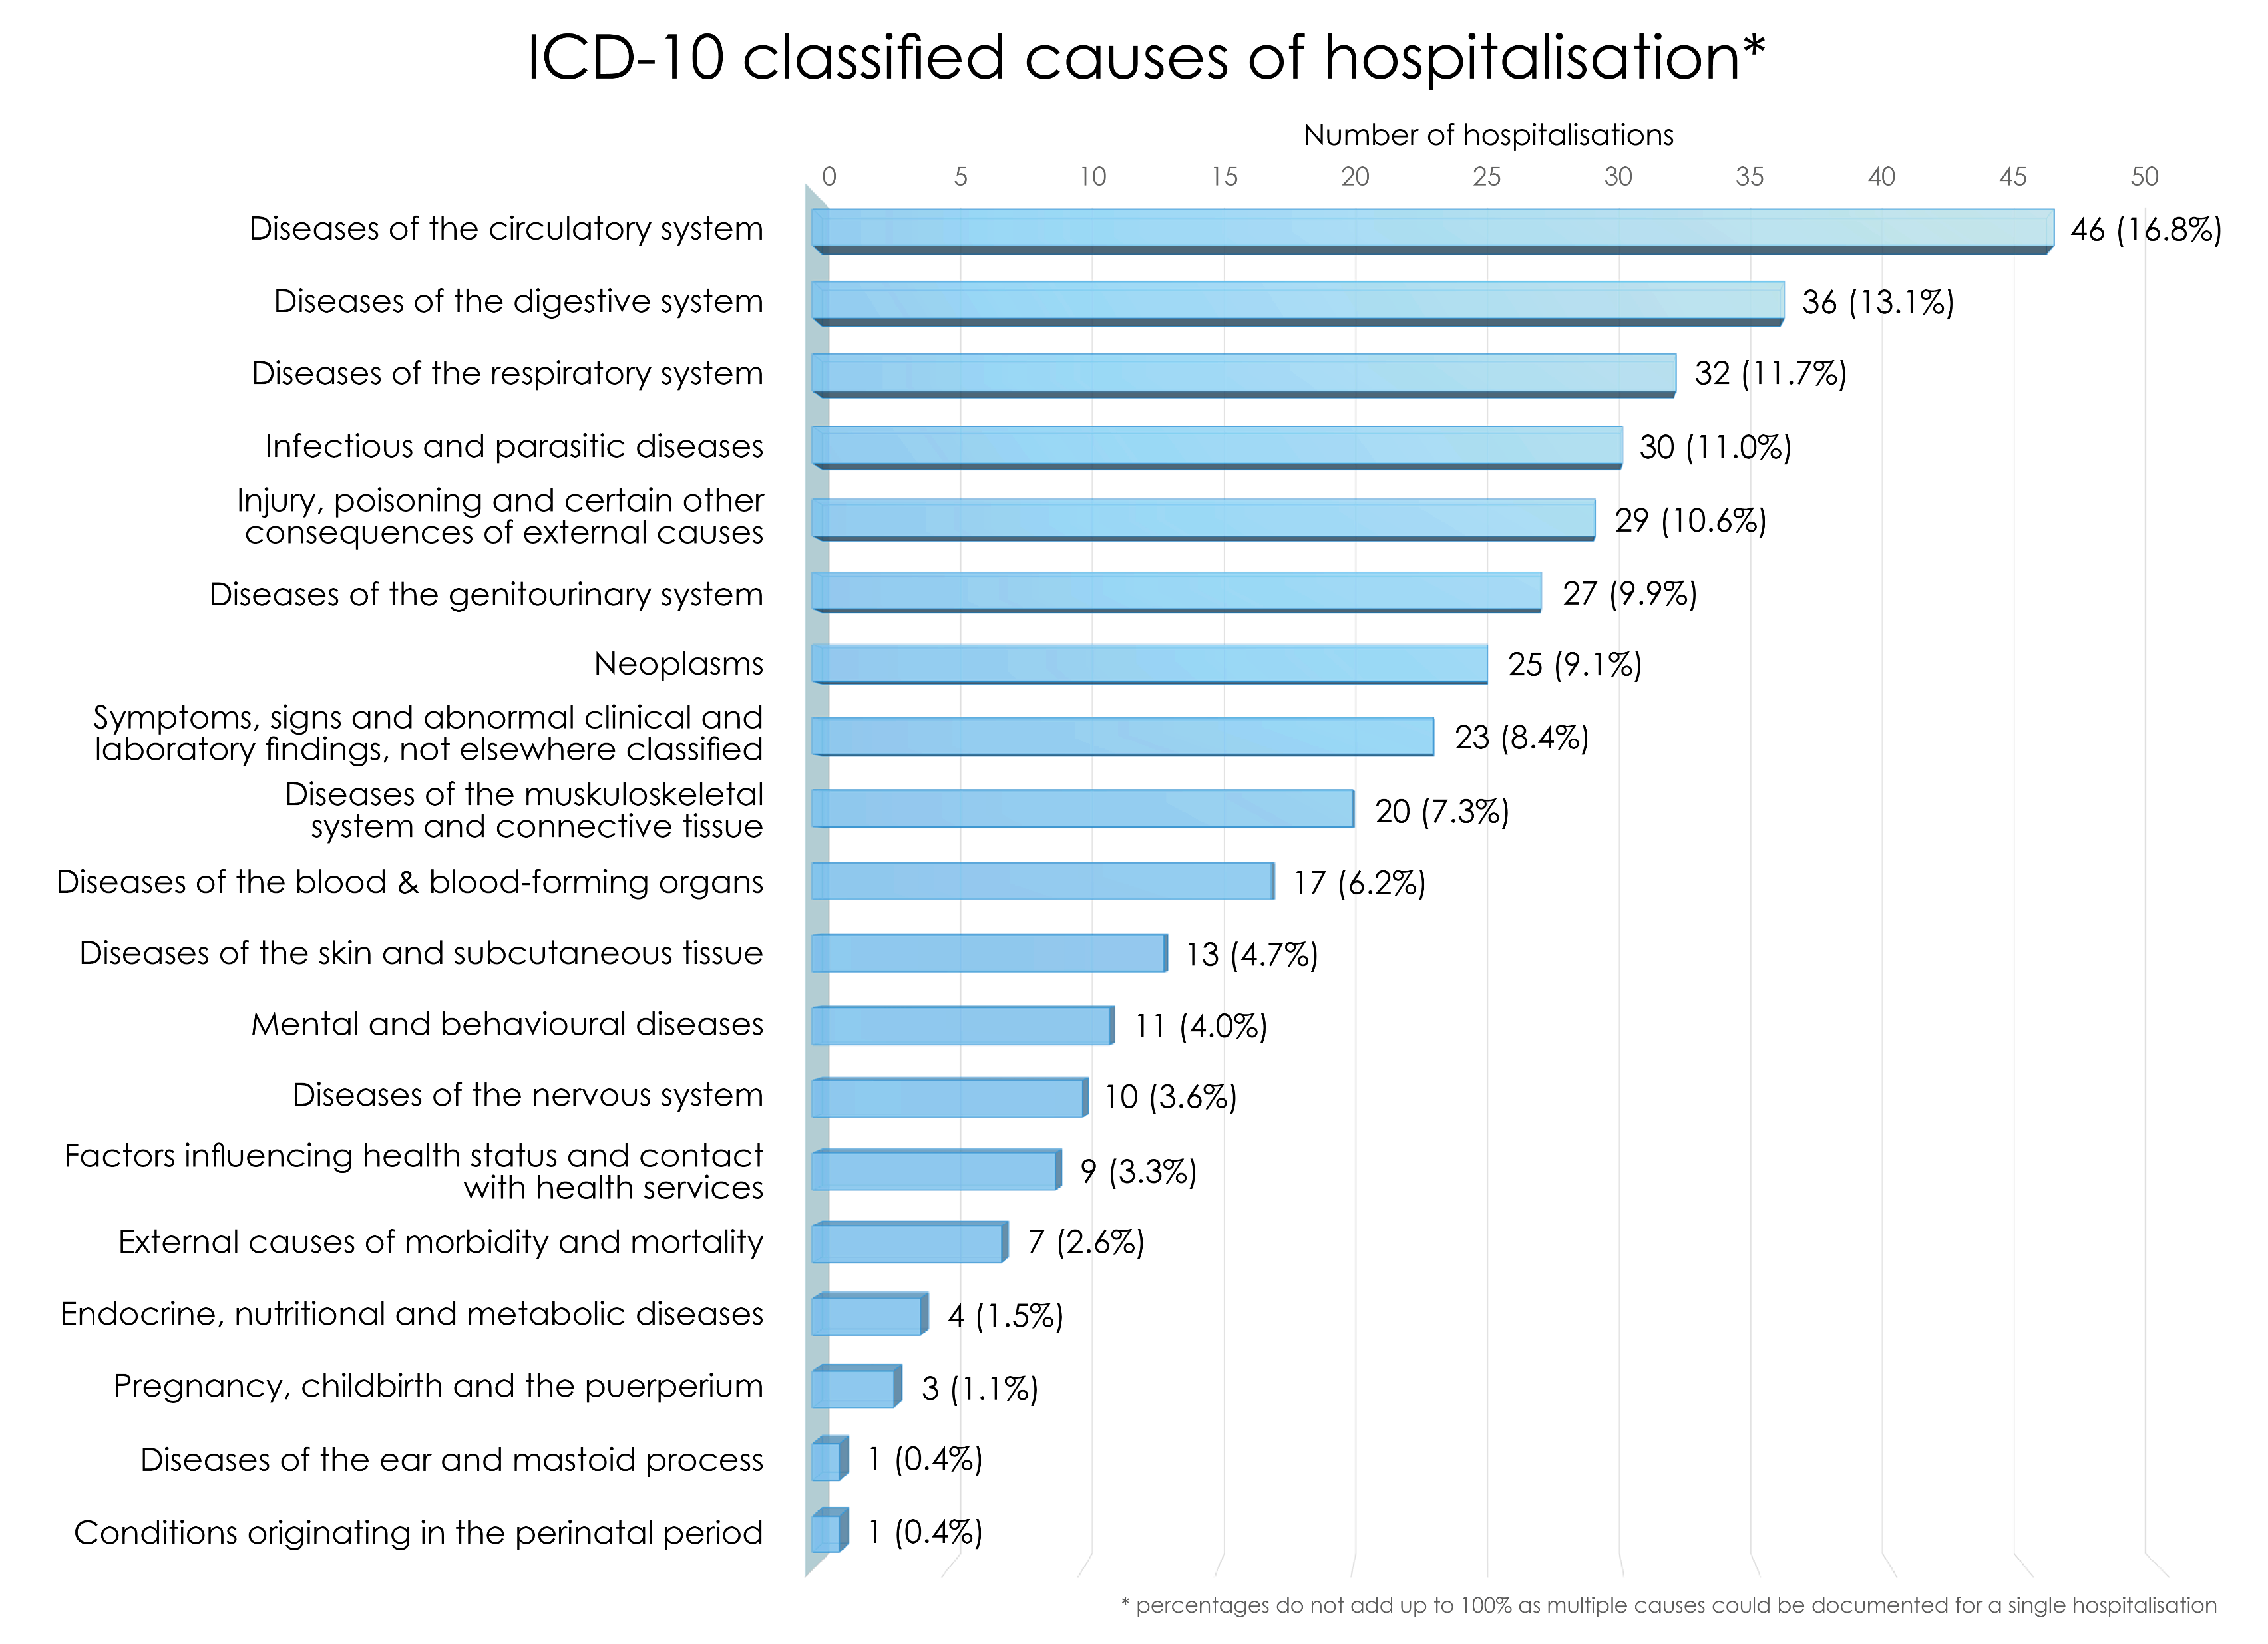
Social and socioeconomic disadvantage, poor mental health and adverse lifestyle factors are strong predictors of hospitalisation in people living with HIV.
Risk of hospitalisation according to social circumstance, socioeconomic, mental health and lifestyle factors and causes for admission in people with HIV in the UK
PEB0096
Sophia Rein¹, Colette Smith¹, Clinton Chaloner¹, Adam Stafford², Alison Rodger¹ Margaret Johnson², Jeff McDonnell¹, Fiona Burns^{1,2}, Sara Madge², Alec Miners⁴, Lorraine Sherr¹, Simon Collins³, Andrew Speakman¹, Andrew Phillips¹, Fiona Lampe¹
¹Institute for Global Health, UCL, London, UK
²Royal Free Hampstead NHS Trust, London, UK
³HIV i-Base, London, UK
⁴London School of Hygiene and Tropical Medicine (LSHTM), London, UK
Correspondence: sophia.rein.17@ucl.ac.uk
 | Unadjusted HR (95% CI) | p-value | Demographic adjusted HR (95% CI)* | p-value
No stable partner | 1.4 (1.0, 1.8) | 0.0256 | 1.4 (1.1, 1.8) | 0.0170
Has children | 1.5 (1.1, 2.0) | 0.0038 | 1.5 (1.1, 2.1) | 0.0171
Social support score (vs. 1, highest) 2 3 4 5 (low) | 1.2 (0.9, 1.7) 1.0 (0.7, 1.6) 1.4 (0.9, 2.0) 1.6 (1.0, 2.5) | 0.3486 | 1.2 (0.9, 1.7) 1.0 (0.7, 1.6) 1.4 (0.9, 2.0) 1.5 (0.9, 2.5) | 0.4084
Non-disclosure of HIV | 1.3 (0.9, 1.8) | 0.1867 | 1.2 (0.9, 1.8) | 0.2824
Non-employment Unemployed Sick / disabled Retired Other | 1.7 (1.2, 2.4) 2.5 (1.8, 3.5) 2.0 (1.3, 3.0) 1.4 (0.7, 2.6) | <0.0001 | 1.6 (1.1, 2.3) 2.4 (1.7, 3.4) 1.3 (0.8, 2.2) 1.4 (0.7, 2.9)
Housing (vs. homeowner) Renting Temporary / unstable / other | 1.6 (1.2, 2.2) 1.4 (0.8, 2.2) | 0.0151 | 1.7 (1.3, 2.4) 1.5 (0.9, 2.4) | 0.0028
Education (vs. University) Below university No qualifications | 1.0 (0.7, 1.2) 1.4 (1.0, 2.1) | 0.1112 | 1.0 (0.7, 1.2) 1.3 (0.9, 1.9) | 0.3545
Money for basic needs? (vs. always) Mostly Sometimes No | 1.2 (0.9, 1.6) 1.4 (1.0, 2.0) 1.7 (1.2, 2.6) | 0.0409 | 1.2 (0.9, 1.7) 1.4 (1.0, 1.9) 1.8 (1.2, 2.8) | 0.0415
Smoking (vs. never) Ex-smoker Current smoker | 1.1 (0.8, 1.5) 1.4 (1.0, 1.8) | 0.1288 | 1.1 (0.8, 1.5) 1.4 (1.0, 1.9) | 0.1129
Alcohol dependency on CAGE | 1.2 (0.9, 1.7) | 0.1894 | 1.3 (0.9, 1.7) | 0.1668
Drug use in past 3 months (vs. no) Non-IDU chemsex drugs Non-IDU other IDU | 0.8 (0.5, 1.2) 0.9 (0.7, 1.2) 1.8 (1.2, 2.7) | 0.0116 | 1.0 (0.6, 1.7) 1.0 (0.7, 1.3) 2.1 (1.3, 3.4) | 0.0091
Depressive symptoms according to PHQ-9 (vs. none) Mild Moderate Severe | 1.3 (0.9, 1.9) 1.6 (1.2, 2.3) 1.8 (1.3, 2.6) | 0.0070 | 1.3 (0.9, 2.0) 1.7 (1.2, 2.4) 1.9 (1.3, 2.8) | 0.0048
Anxiety symptoms according to GAD-7 (vs. none) Mild Moderate Severe | 1.4 (1.0, 1.9) 2.0 (1.4, 2.8) 1.3 (0.9, 1.9) | 0.0016 | 1.4 (1.0, 1.9) 2.1 (1.4, 3.0) 1.3 (0.9, 2.0) | 0.0015
PHQ-9 depression and being treated for depression (vs. no depression, no treatment) PHQ-9 <10, on treatment PHQ-9 ≥10, no treatment PHQ-9 ≥10, on treatment | 1.5 (1.0, 2.4) 1.7 (1.3, 2.3) 1.5 1.0, 2.2) | 0.0025 | 1.7 (1.0, 2.6) 1.9 (1.4, 2.5) 1.5 (1.1, 2.2) | 0.0004
BACKGROUND
Hospitalisation is a key indicator of serious morbidity and a significant contributor to healthcare costs. However, there has been little research on the predictors and causes of hospitalisation among people living with HIV (PLHIV) in the last decade - the era of contemporary combination ART.
METHODS
In a sub-study of the ASTRA questionnaire study, 798 individuals recruited at the Royal Free Hospital, London, who consented to routine clinical data linkage were included.
A medical record review identified occurrence and ICD-10 classified causes of all hospital admissions from questionnaire completion (2011-2012; baseline) until 1 June 2018.
We used Prentice-Williams-Peterson gap time models to calculate unadjusted and demographic adjusted hazard ratios (HR) of repeated all-cause hospitalisation according to baseline questionnaire assessed social, socioeconomic, mental health and lifestyle factors.
RESULTS
274 hospitalisations occurred (153 (19%) had ≥1 hospitalisation): an overall rate of 5.8/100 person-years (95% CI: 5.1-6.5)
75% of hospitalisations were emergencies
The re-admission rate was 64.2/100 person-years (52.7-75.7)
Factors predicting hospitalisation included: not having a stable partner; having children; being unemployed or non-employment due to being sick/disabled; rented housing; never having enough money for basic needs; current smoking; recreational injection drug use; anxiety symptoms; depressive symptoms; treated and untreated depression
Being a heterosexual man or a woman with ethnicity other than Black African (vs. MSM); being aged >60; lower CD4 count; CD4 nadir <50; viral non-suppression; greater ART non-adherence and time since diagnosis >20 years were also associated with higher hazard of hospitalisation
Causes of hospitalisation were wide-ranging, the most common were circulatory, digestive, respiratory, infectious diseases, injury/poisoning, genitourinary diseases and neoplasms in that order. 10% were related to at least one AIDS-defining illness.
CONCLUSIONS
Our findings emphasize the need for support targeted to those with psychosocial and economic needs and highlight the importance of holistic care for PLHIV including prevention and early detection of comorbidities. Given the high costs of hospitalisation targeted interventions could be cost-effective.
Causes of hospitalisation are wide-ranging and not primarily AIDS-related.
IDU=injection drug use; *adjusted for demographic group, age, years since HIV diagnosis
Acknowledgments
This work was supported by a BHIVA Research Award 2017.
The ASTRA and AURAH studies present independent research funded by the National Institute for Health Research (NIHR) under its Programme Grants for Applied Research funding scheme (RP-PG-0608-10142). The ASTRA and AURAH Study Groups acknowledge the support of the NIHR, through the Comprehensive Clinical Research Network.
The views expressed in this presentation are those of the authors and not necessarily those of the NHS, the NIHR, or the Department of Health.
We thank all study participants for their time and effort, and gratefully acknowledge the contributions of all the ASTRA clinic teams in recruitment and data collection.
ASTRA clinic teams at Royal Free Hospital: Alison Rodger; Margaret Johnson; Jeffrey McDonnell; Aderonke Adebiyi. ASTRA core team: Fiona Lampe; Alison Rodger; Andrew Speakman; Andrew Phillips. ASTRA data management: Andrew Speakman; Marina Daskalopoulou; Fiona Lampe. ASTRA advisory group: Lorraine Sherr; Simon Collins; Jonathan Elford; Alec Miners; Anne Johnson; Graham Hart; Anna-Maria Geretti; Bill Burman. CAPRA grant Advisory Board: Nick Partridge; Kay Orton; Anthony Nardone; Ann Sullivan.
PRESENTED AT THE 23RD INTERNATIONAL AIDS CONFERENCE (AIDS 2020) | 6-10 JULY 2020

